Slide 1
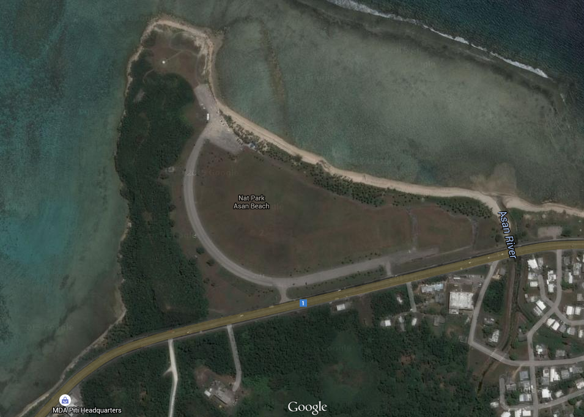
Kat
148.972
Lost here
**Don’t know if the numbers on the lost beetles are correct….or if they matter
148.703
Lost here
148.641 somewhere in the swamp

